Slide 1
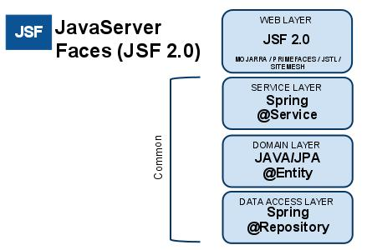

Slide 2
Java 1.8
Spring 5.x
Hibernate 4.X
Soap UI
Junit
Maven
Jboss
Eclipse Neon
SonarQube
SVN /GitHub

Slide 3
UI Layer
View Layer
Angular 6
Controller Layer
Frontend service layer
Integration Layer
Service Layer
Application server
Tomcat 9
Spring 5
Spring Web Services
Spring Batch
Spring Security
Spring DATA JPA
Business Layer
JAVA 1.8
JUNIT 5
SonarQube 7.6
Elastic search 6.6
Data
Layer
MY SQL

Slide 4
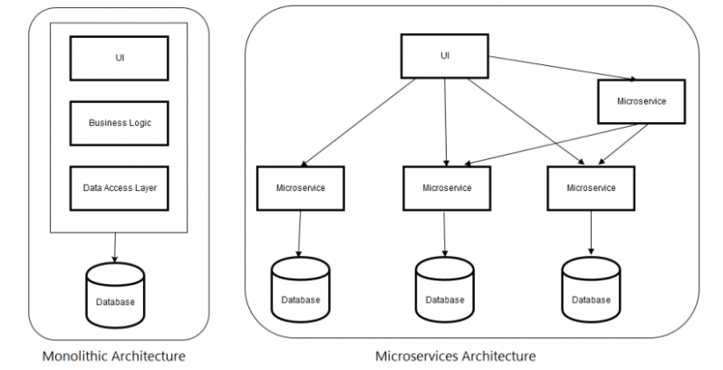

Slide 5
Gateway API / Eureka
Kubernetes
Gateway API / Eureka

Slide 6


Bulk Upload Service
Flow execution steps
UI Angular
User Selects Bulk Upload from UI which calls Bulk Upload API
Bulk Upload API calls Bulk Upload Service
Bulk Upload Service retrieve configure details and orchestrate system services calls in sequence configured for this use case
Business rules are performed on the message and if any failure will be logged and notified as configured
Validate the Uploaded file based on business rules
File process
Generate CSV file
Raise ticket for each CSV file and get the Remedy ID
Insert work list entry for each CSV file
Insert Audit Logs
Send Notification
1
API Gateway
2
Bulk Upload API
Process
Microservices
Bulk Upload
Services
3
Remedy Service
8
5
Business
Rule Service
Notification Service
11
7
Generate CSV Service
Audit Log Service
10
9
Work List Service
File Validation
4
6
File Process

Slide 7

Amazon Cloud
Gateway API
Micro service
DB
Https
Https
Micro service
DB
Angular 6
Https
Https
Https
Identity Server
Open ID

